Slide 1
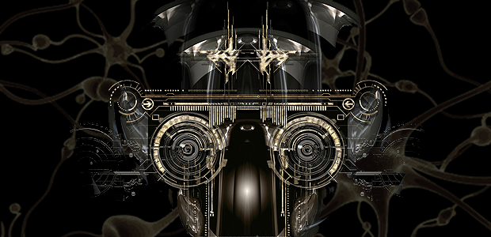
Computer vision and Artificial intelligence

Slide 2
Computer vision Method
IMAGE ACQUIRING
PROCESSING
RECOGNITION
FEATURE DETECTION AND EXTRACTION
MOTION
HIGH LEVEL PROCESSING
DECISION MAKING

Slide 3
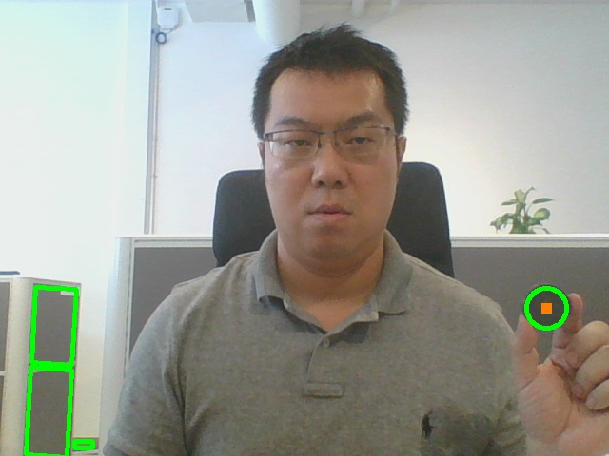
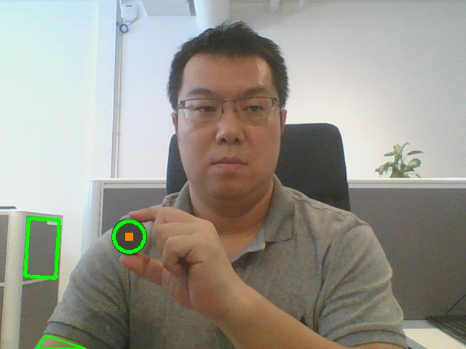

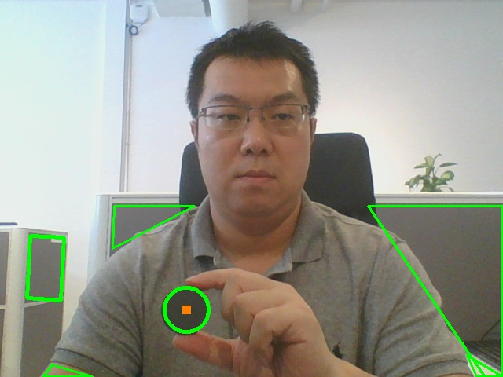
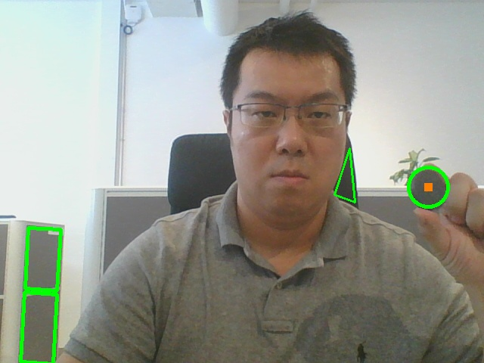
Computer vision objects detection and recognition in motion - 1

Slide 4
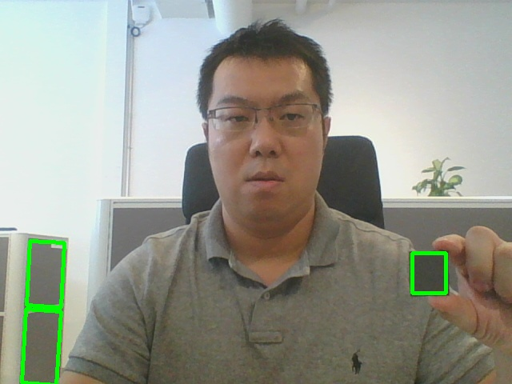
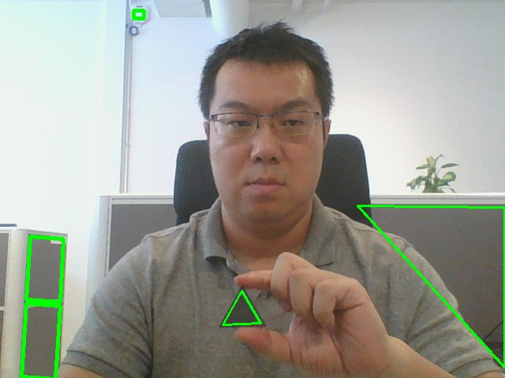
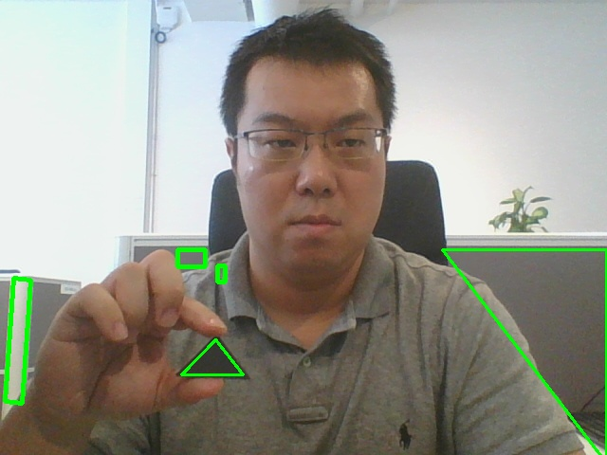
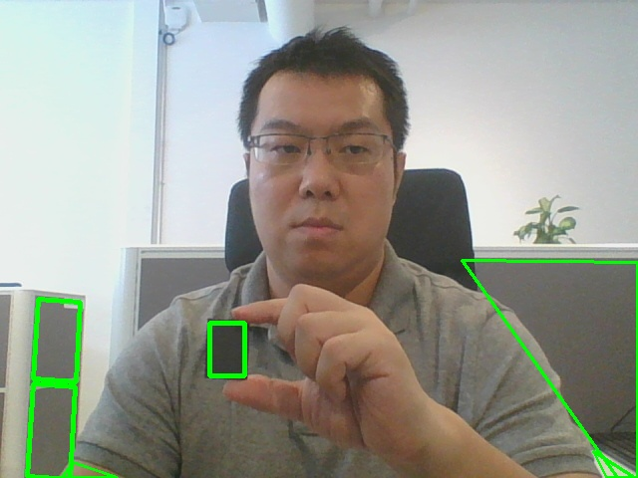
Computer vision objects detection and recognition in motion - 2

Slide 5
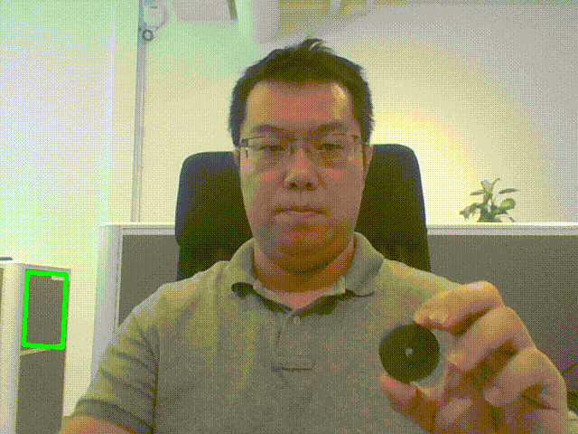
Computer vision objects detection and recognition in motion - 3

Slide 6
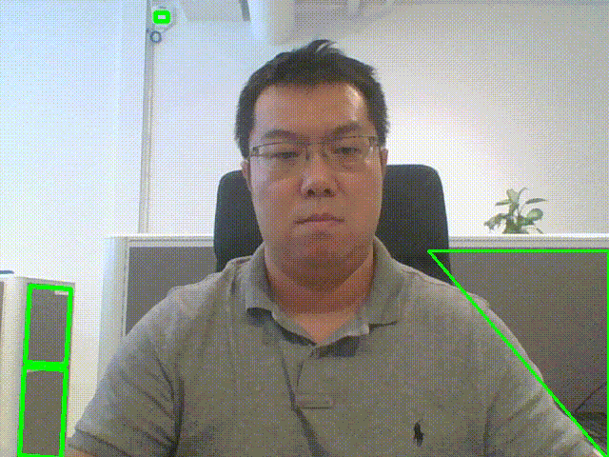
Computer vision objects detection and recognition in motion - 4

Slide 7
Computer vision objects detection and recognition
With those basic elements, more complex objects can be detected and recognized
Complex objects can be divided and described using basic elements
Works with not only static objects, but also moving objects

Slide 8
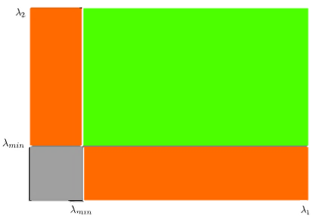
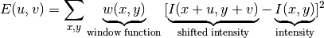
Computer vision Feature detection: Shi-Tomasi method example
Shi-Tomasi Corner Detection and Ramer-Douglas-Peucker split-and-merge algorithm
Shi-Tomasi: Use Scoring function to find variation of intensity for a displacement in every direction of a small window of an image.
Window function gives weights to pixels. Our goal is to Maximize the shifted intensity component of the function.
If value is greater than threshold value its considered a corner (green region)
(Threshold)

Slide 9
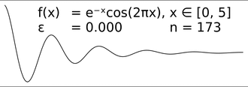
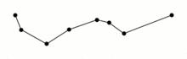
Computer vision Feature matching: Ramer-Douglas-Peucker method example
Ramer-Douglas-Peucker: Find similar curve with fewest number of points by recursively dividing the segment and comparing the proximity of the new simplified line to the original curve.
If the point furthest from the segment is larger than the original by a distance ε > 0, it must be kept. The function recursively calls itself with the first point and the furthest point marked as kept

Slide 10
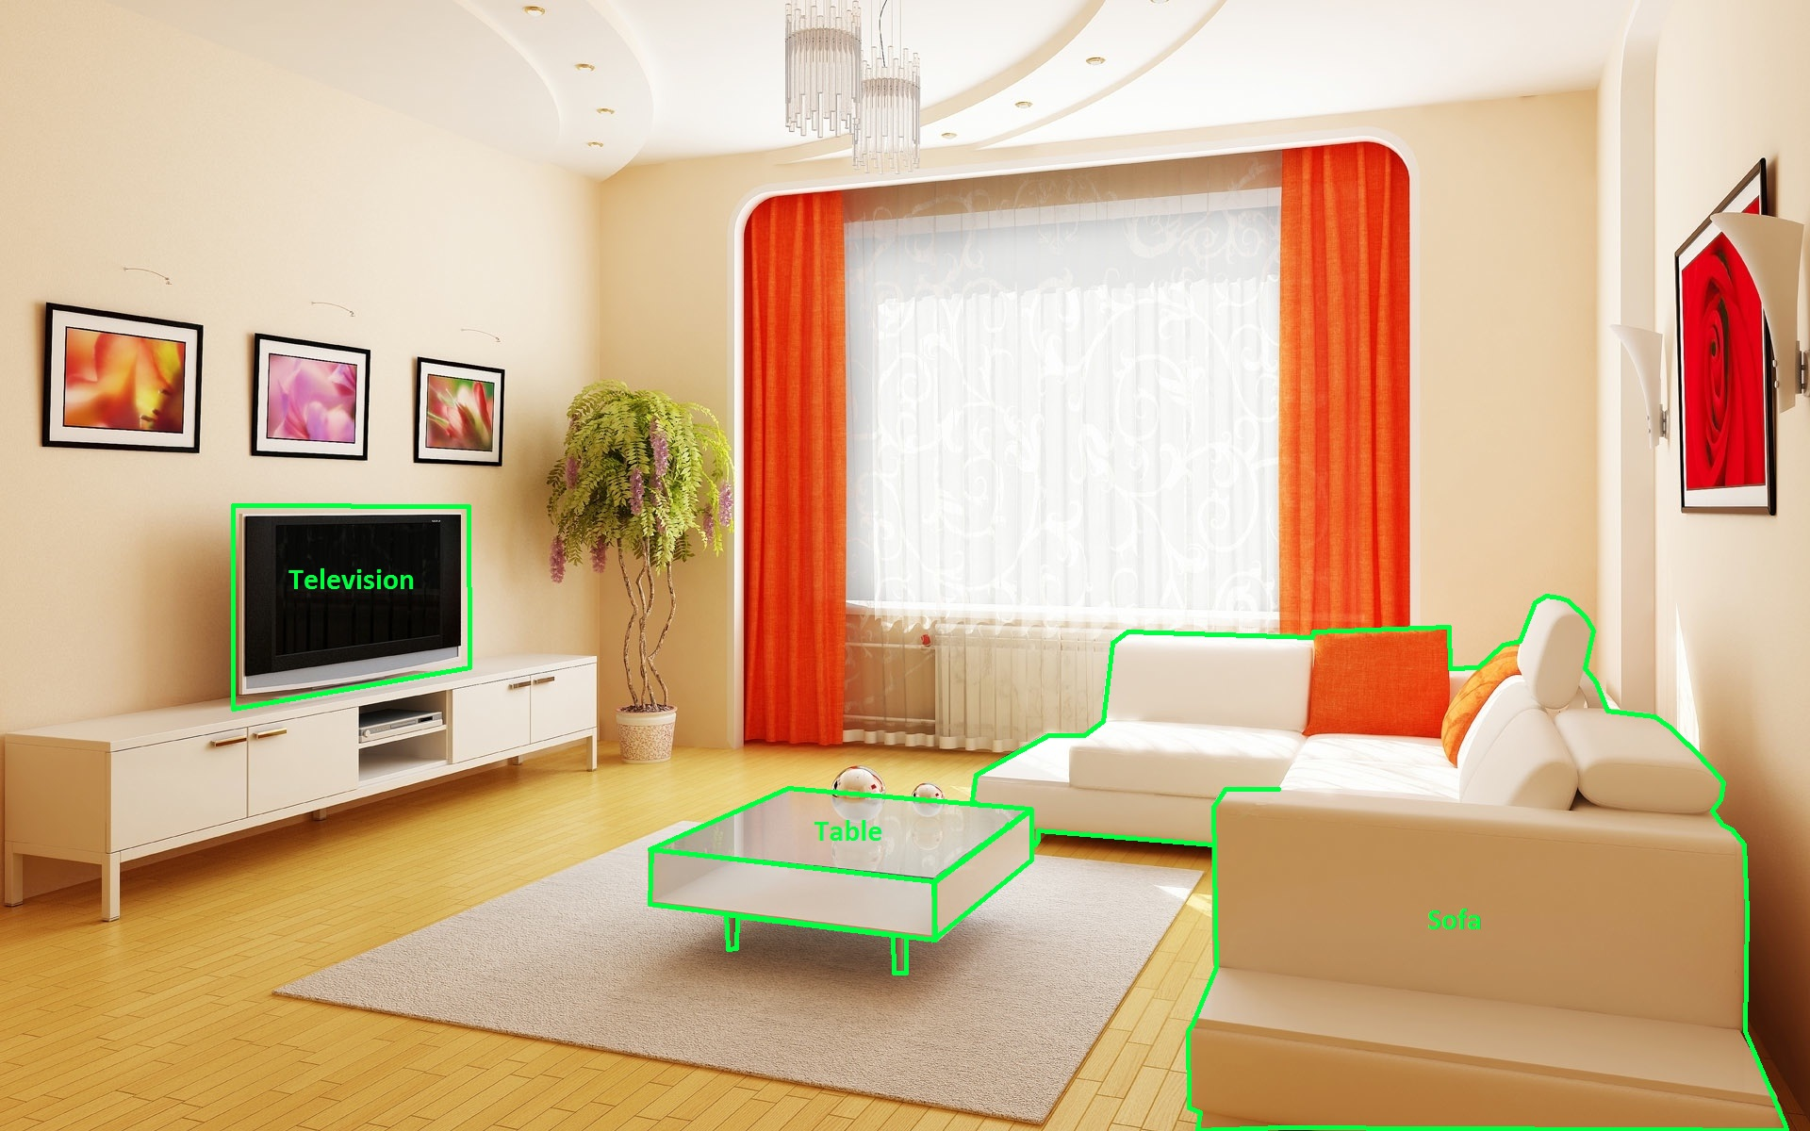
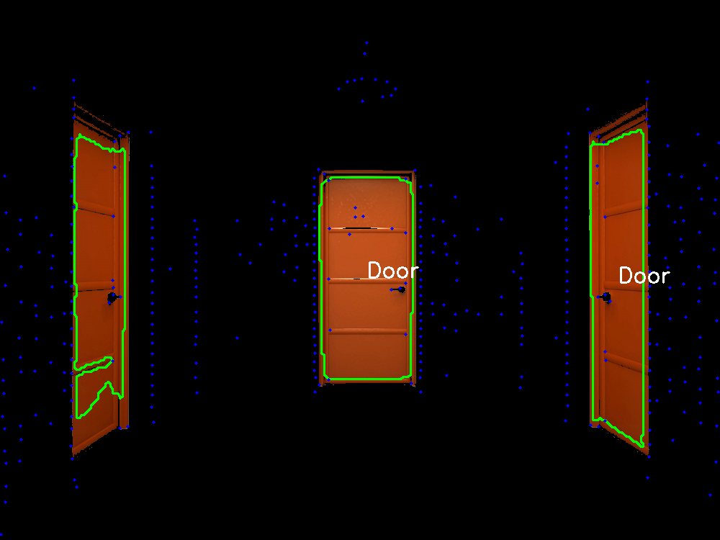
Computer vision room setup and door detection

Slide 11
Computer vision work with AI
Complex patterns can also be recognized and described
Additional features such as colour and dimension can be detected
Data will be summarized and classified for feature matching analysis and future machine learning

Slide 12
AI – Machine learning classification from critical features
Different flowers were selected as a follow-up example of machine learning
The difference between flowers is very minor, hard for human eyes to tell
Computer vision and machine learning is the solution
The solution can be applied to many different scenarios

Slide 13
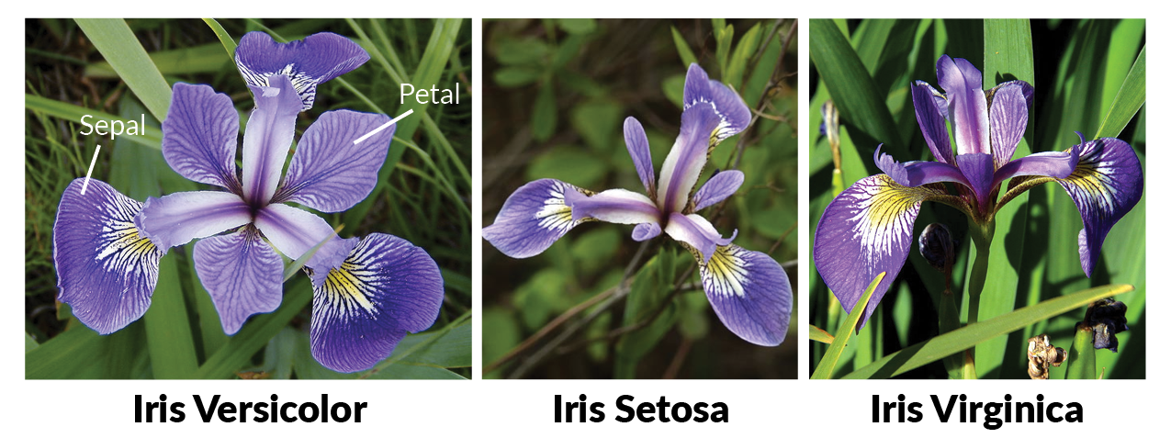
AI – Machine learning flower classification from critical features

Slide 14
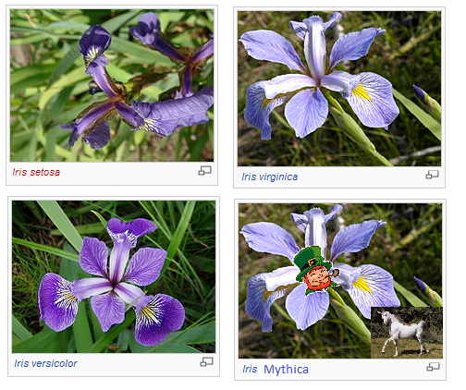
AI – Machine learning flower classification and prediction

Slide 15
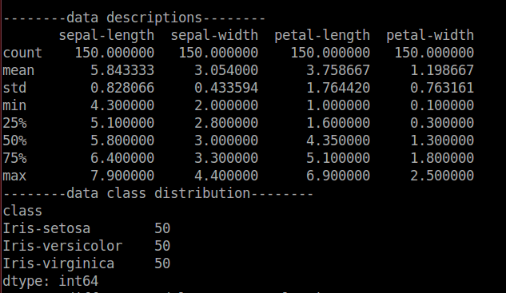
AI – Machine learning data description

Slide 16
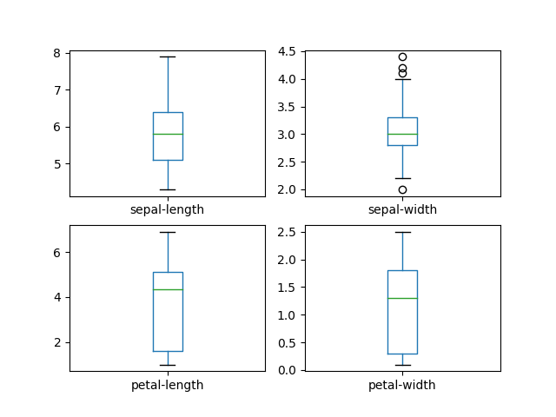
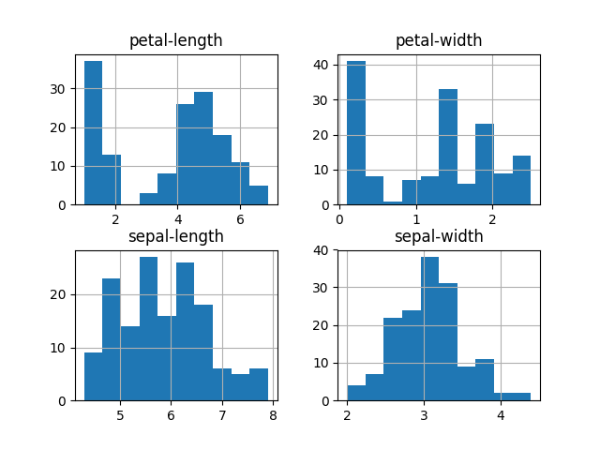
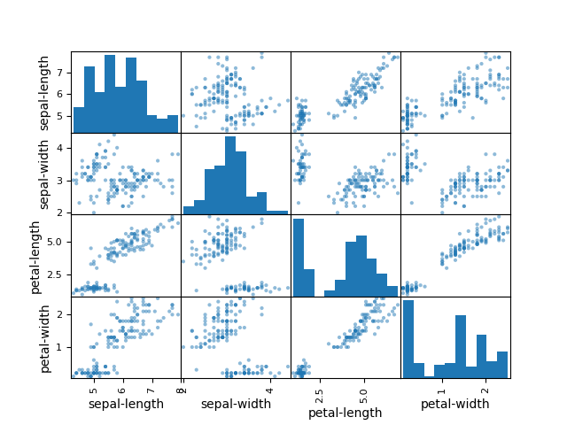
AI – Machine learning data classification

Slide 17
AI – Machine learning studied with different models
LR - LogisticRegression
LDA - LinearDiscriminantAnalysis
KNN - KNeighborsClassifier
Cart - DecisionTreeClassifier
NB - GaussianNB
SVM – Support Vector Machine
RF - Random Forest

Slide 18
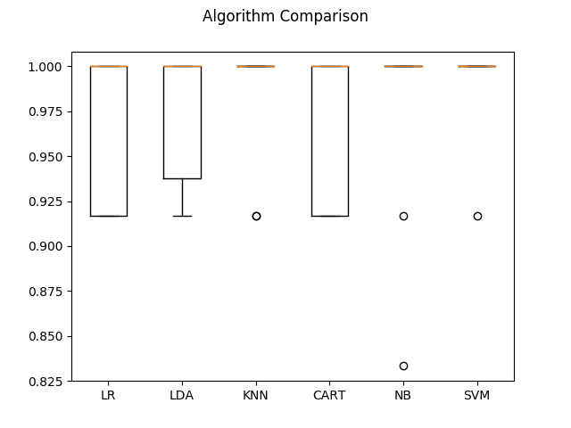
AI – Machine learning algorithm comparison

Slide 19
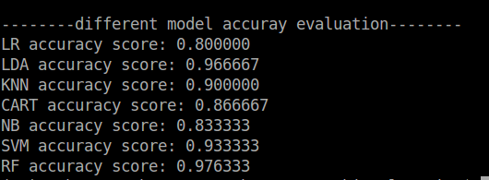
AI – Machine learning different model accuracy evaluation using random seed

Slide 20
AI – Machine learning
By Computer Vision the robot is able to extract critical features from objects
The critical features category can be surprisingly low compared with complex appearance (only 4 types of different features in this example)
The robot can learn from information of critical features and improve
The robot can apply different models to adapt to the process
The robot can make accurate recognition for the objects

Slide 21
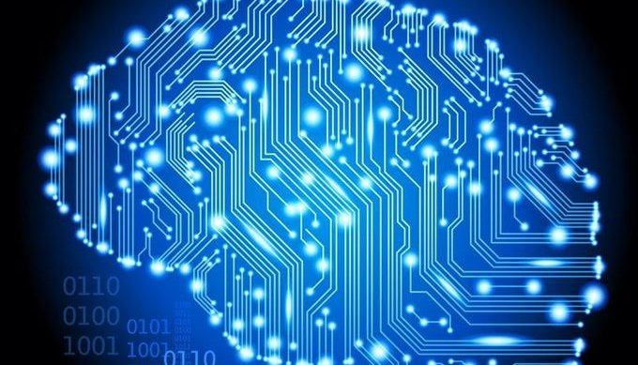
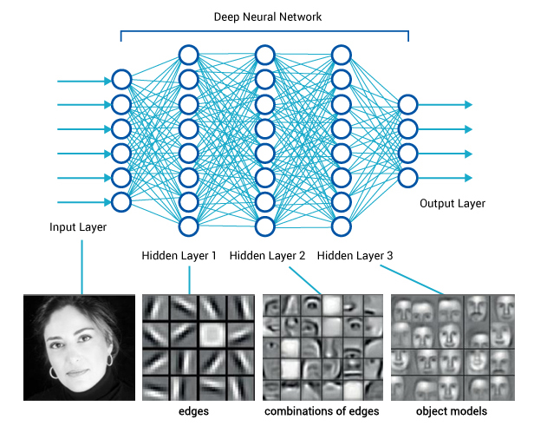
AI – Deep learning
Deep learning (deep structured learning or hierarchical learning)
Artificial Neural Networks (simulate human brain)

Slide 22
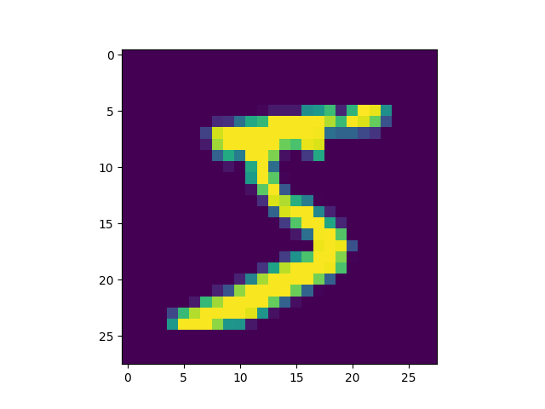
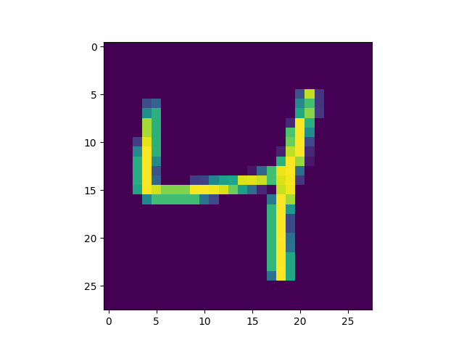
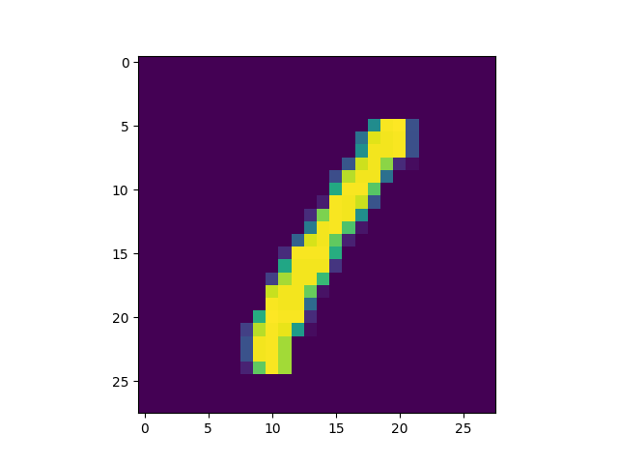
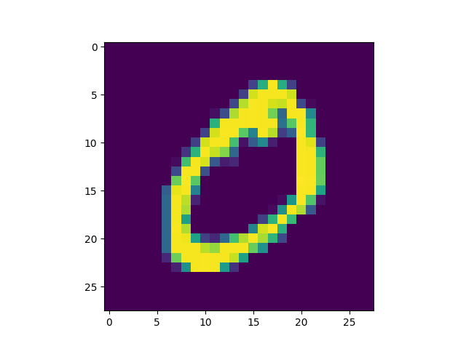
AI – Deep learning Example of handwritten digits database
The example already has big data sets and is suitable to demo the complexity and power of deep learning
The technology can be used for different targets, for example animals, cars, humans and so on

Slide 23
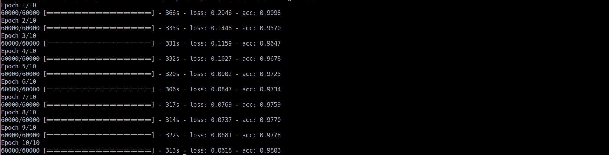
AI – Deep learning processing results and accuracy
60000 images with 28x28 pixels
7 layers of neural network
10 epochs were selected, batch size uses 32, ‘acc’ represents for accuracy

Slide 24
AI – Deep learning
Abstraction and presentation
Big Data
The target have many different variations
Environment
Can handle very complex problems
Results are excellent

Slide 25
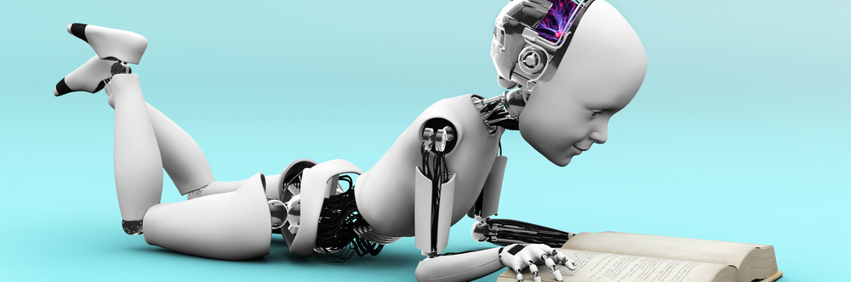
Thank you!
AI is watching

